Slide 1
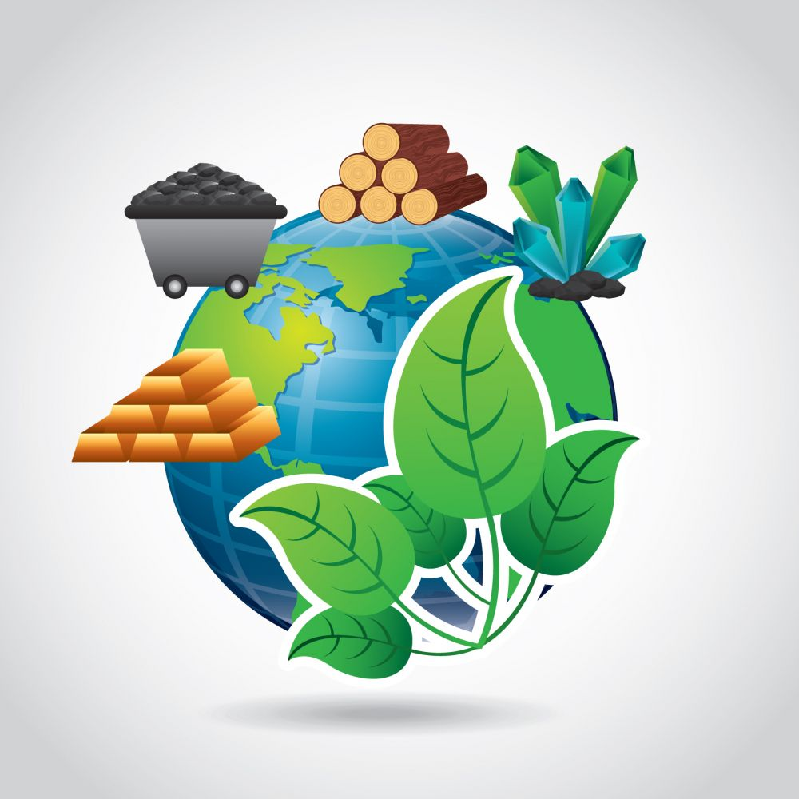
Daily Review
Earth’s Resources
A resource is any naturally occurring thing that can be used to satisfy the needs of humans or other living things.
Think, pair, share: What is the definition of a resource?
On your whiteboard, write down three commonly used resources.

Slide 2
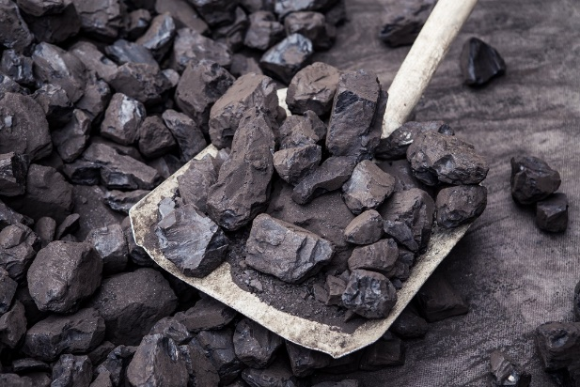
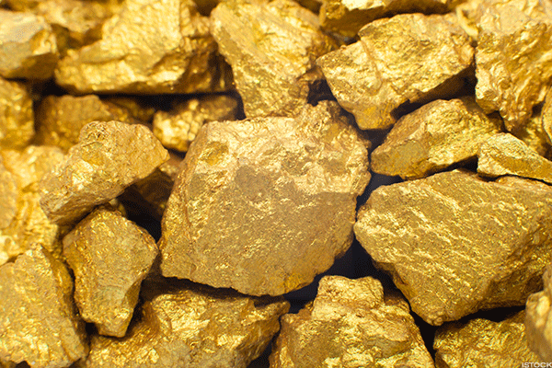
Daily Review
Non-renewable Resources
Non-renewable resources can run out: only a limited amount of them is available.
They cannot come back after they have been used (or they take an extremely long time to come back).
Think, pair, share: What is a non-renewable resource?
Think, pair, share: Why are coal and gold classed as non-renewable resources?
Vocabulary
non-renewable (adjective) a natural resource that can be used up and does not replenish itself (or replenishes very slowly)

Slide 3

Daily Review
Renewable Resources
There are two types of renewable resources:
Continuous renewable resources, which can never run out
Non-continuous renewable resources, which can be used up but can come back over time
Think, pair, share: What is the difference between continuous and non-continuous renewable resources?
Think, pair, share: Would sunlight be classed as a continuous or non-continuous renewable resource? Explain your choice.
Vocabulary
renewable (adjective) a natural resource that either cannot run out or can replenish itself when used

Slide 4
Non-Renewable Resources Year 7 Science

Slide 5
Learning Objectives
Describe different types of non-renewable resources.
Identify advantages and disadvantages of non-renewable resources
CFU 1
What type of resources will we be learning about today?
Activate Prior Knowledge
On your whiteboard, name two non-renewable resources and state how humans use them.

Slide 6
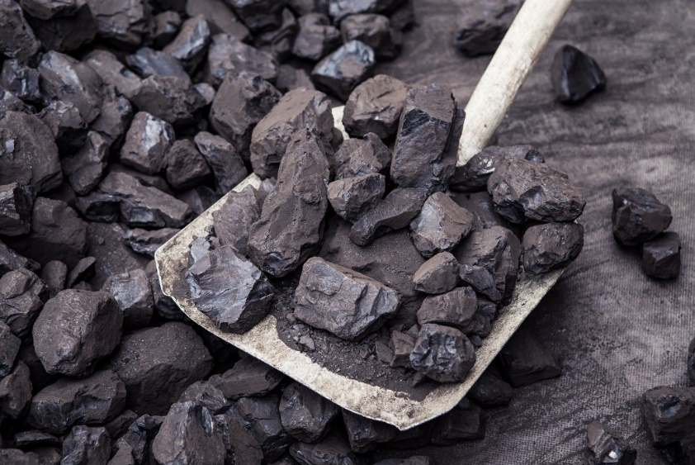
Concept Development
CFU 1
What makes a resource non-renewable?
Non-Renewable Resources
Non-renewable resources can run out: only a limited amount of them is available.
They cannot come back after they have been used (or they take an extremely long time to come back).
CFU 2
Name three resources that are non-renewable.

Slide 7
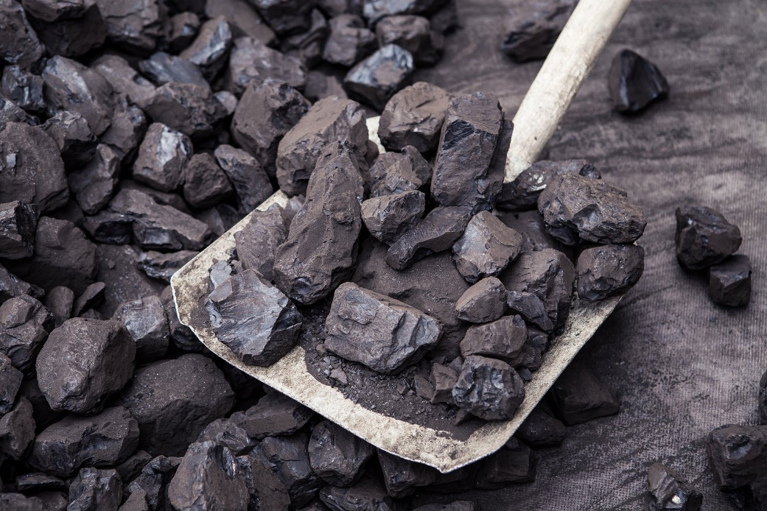
Concept Development
CFU 1
Why do we use non-renewable resources to produce energy or make products to use?
Advantages of Non-Renewable Resources
Even though non-renewable resources can run out, we still use them to make many products or to produce energy.
Some of the advantages of using non-renewable resources are:
They are easy to transport
They are reasonably cheap
They are plentiful

Slide 8
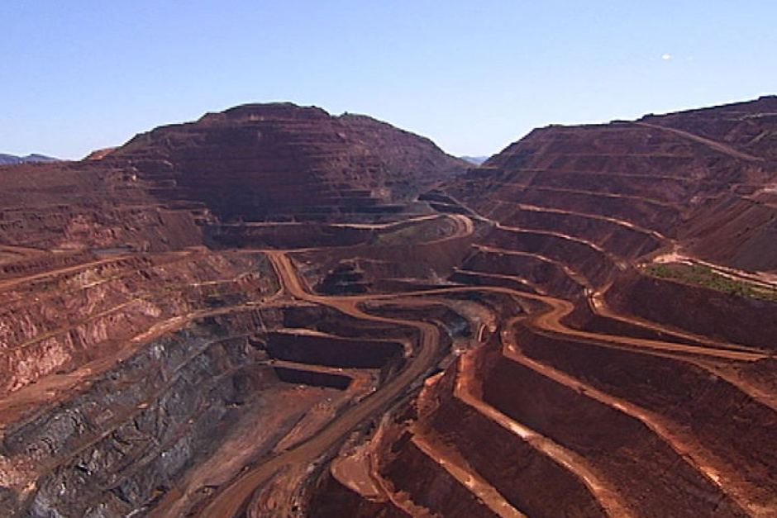
Concept Development
CFU 1
What are some reasons why people are using fewer non-renewable resources?
Disadvantages of Non-Renewable Resources
While non-renewable resources are used often, they have some disadvantages.
Some of the disadvantages of using non-renewable resources are:
They can cause pollution to air and water
They can cause damage to the environment through mining
They can produce waste products that are hard to dispose of properly

Slide 9
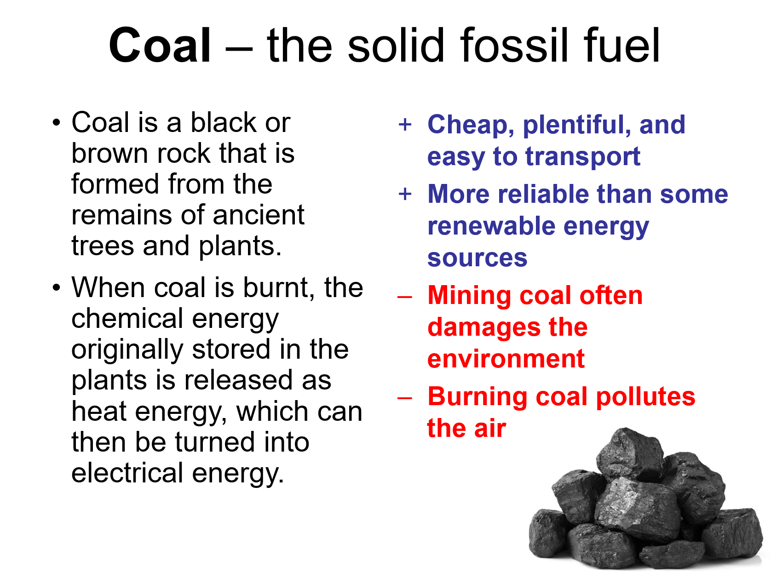
Skill Development / Guided Practice
Filling out your graphic organiser
You need to include the following information on your graphic organiser for each non-renewable resource
What it is
How it is used
Advantages
Disadvantages

Slide 10
Independent Practice
Use the information on the cards provided to complete the graphic organiser.

